Slide 1
CAPSTONE PROJECT
Cardiovascular Risk Prediction
Presented By:
Afrin Banu Ibrahim – St. Peter’s College of Engineering and Technology – Btech Biotechnology.

Slide 2
OUTLINE
Problem Statement
Proposed System/Solution
System Development Approach
Algorithm & Deployment
Result
Conclusion
Future Scope
References

Slide 3
PROBLEM STATEMENT
The dataset is from an ongoing cardiovascular study on residents of the town of Framingham, Massachusetts. The classification goal is to predict whether the patient has a 10-year risk of future coronary heart disease (CHD). The dataset provides the patients’ information. It includes over 4,000 records and 15 attributes. Each attribute is a potential risk factor. There are both demographic, behavioral, and medical risk factors.

Slide 4
PROPOSED SOLUTION
Examining Potential Risk Factors for Coronary Heart Disease (CHD) in the Framingham Heart Study: An Exploratory Data Analysis
This study aims to conduct an exploratory data analysis (EDA) on the Framingham Heart Study dataset to identify potential risk factors associated with a 10-year risk of coronary heart disease (CHD).
Methodology:
Data Acquisition and Exploration:
Acquire the Framingham Heart Study data containing demographic, behavioral, and medical information for participants.
Perform descriptive analysis to understand the data structure, variable types, and presence of missing values.
Risk Factor Analysis:
Focus on the "10-year CHD risk" variable as the target variable.
Analyze the distribution of CHD risk across different potential risk factors, including demographics (age, sex), behavioral habits (smoking status), and medical history (blood pressure, cholesterol levels).
Data Visualization:
Employ visual representations like histograms, boxplots, and scatterplots to explore relationships between CHD risk and potential risk factors.
Visualizations will help identify trends and potential associations between variables.

Slide 5
SYSTEM APPROACH
Data Acquisition: This is the first step, similar to defining the system boundaries in a system approach. We acquire the Framingham Heart Study data, which represents the system of interest.
Data Exploration: Here, we analyze the data's components, analogous to examining individual parts within a system. We understand the data structure, variable types, and missing values, gaining insights into the system's building blocks.
Risk Factor Analysis: This step focuses on specific variables (potential risk factors) and their interactions with the target variable (CHD risk). It's similar to analyzing how specific components within a system might influence the overall system behavior.
Data Visualization: Visualizations help us see relationships between variables, akin to visualizing interactions and flows within a system.
Preliminary Findings: This stage summarizes the initial understanding of the data and potential risk factors, similar to drawing initial conclusions about the system's behavior based on component analysis.

Slide 6
ALGORITHM & DEPLOYMENT
Stepwise Algorithm:
Import Libraries: Load libraries for data manipulation, visualization, and machine learning.
Load Data: Read the CSV file into a Pandas DataFrame.
Explore Data: Analyze data dimensions, missing values, descriptive statistics, and create visualizations for initial insights.
4. Train Model (not shown): Train the model with the training data.
5.Evaluate Model (not shown): Use the testing data to assess model performance with metrics like accuracy and confusion matrix.
6.Refine Model (optional): Improve model performance by adjusting hyperparameters, exploring different algorithms, or applying feature engineering.
7.Deploy Model (optional): Integrate the trained model for real-world use (if applicable).

Slide 7
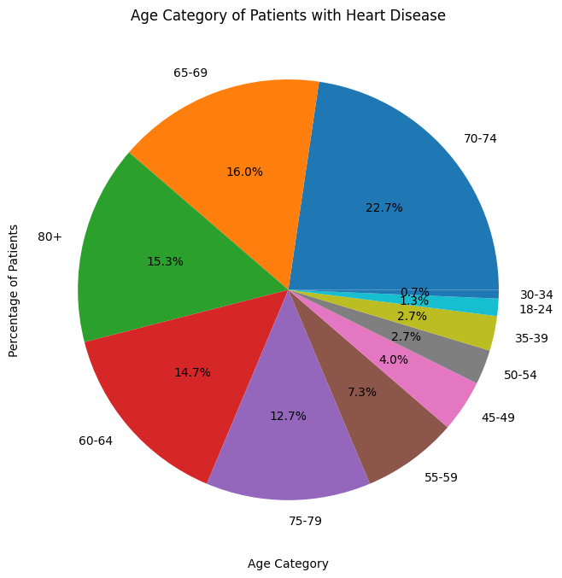
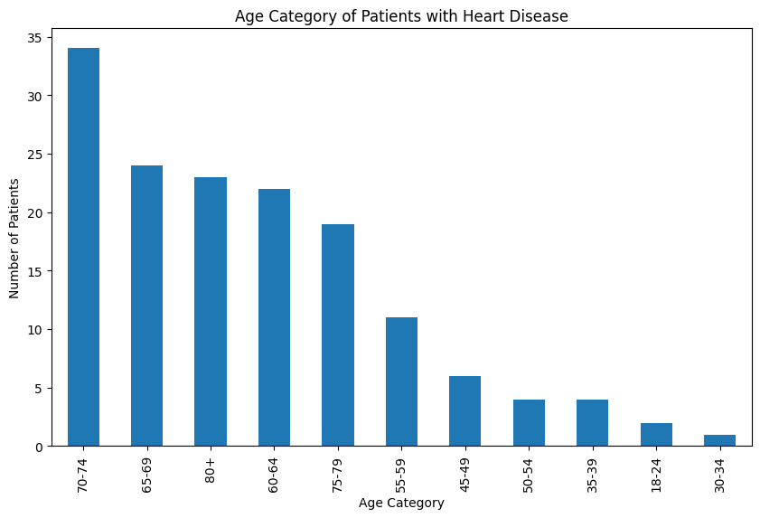
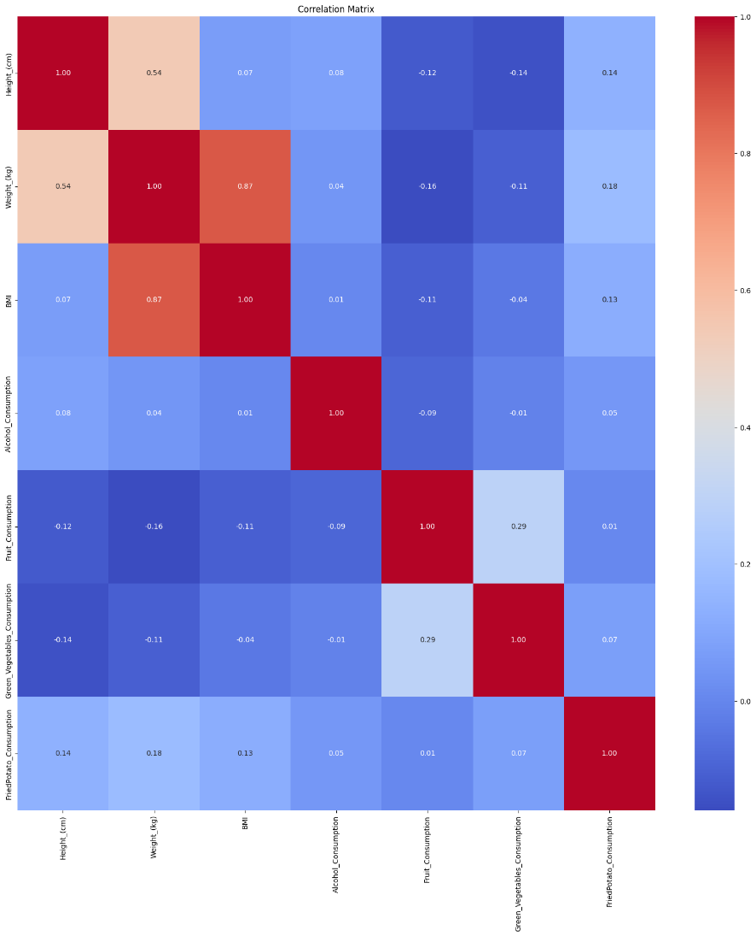
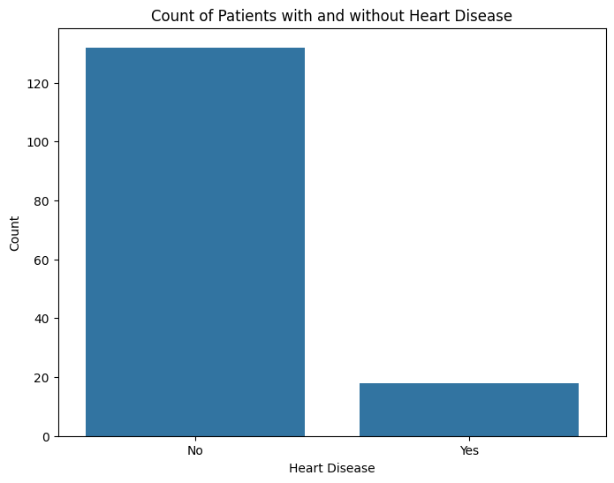
RESULT

Slide 8
CONCLUSION
This algorithm outlines a stepwise approach for building and evaluating a machine-learning model to predict heart disease using a dataset. The initial exploration provides insights into the data and potential relationships between variables. Preprocessing steps ensure the data is suitable for model training. Splitting the data allows for unbiased model evaluation. While the code snippet focuses on exploration and visualization, subsequent steps would involve building and training a model (e.g., Random Forest Classifier), evaluating its performance on unseen data, and potentially refining the model for better predictions. This framework provides a foundation for further analysis and development of a heart disease prediction model.

Slide 9
FUTURE SCOPE
The future holds promise for this heart disease prediction model:
Advanced Models: Explore more powerful algorithms like Gradient Boosting or Deep Learning for potentially better predictions.
Feature Engineering: Craft new features from existing data or consider integrating additional data sources like medical history or imaging.
Explainable AI: Uncover the model's "thinking" behind its predictions to improve trust and understanding.
Real-World Applications: Develop tools for healthcare professionals or integrate the model into existing systems for early intervention.
Risk Stratification: Refine risk assessment to optimize resource allocation and personalize prevention strategies.
These advancements can lead to a more accurate, interpretable, and impactful model for heart disease prediction and prevention.

Slide 10
REFERENCES
Scikit-learn (scikit-learn.org): Core library for machine learning algorithms and pipelines (train_test_split, StandardScaler, LabelEncoder, OneHotEncoder, RandomForestClassifier, etc.).
Pandas (pandas.pydata.org): Data manipulation and exploration library (used for data loading and initial analysis).
Seaborn (seaborn.pydata.org): Statistical data visualization library (used for creating visualizations).

Slide 11
THANK YOU

